Slide 1
BEAST2 and Protracted Birth-Death model
By Femke Thon & Jolien Gay
Supervisors:
Richel Bilderbeek & Rampal Etienne
Notes:
NOTE: Some photo’s are placeholders (incomplete pics).

Slide 2
Introduction: What?
Standard Birth-Death model (BD)
Constant speciation and extinction rates
Number of lineages increase constant or accelerated (pull of the present)
BUT: slowdown observed towards the present
[picture]

Slide 3
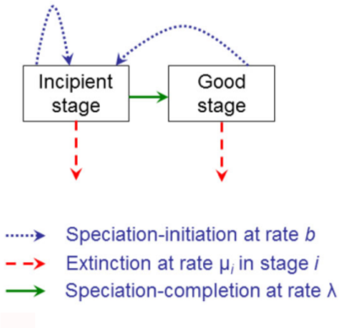
Introduction: What?
Protracted Birth-Death model (PBD)
Extension of BD
Assumes speciation takes time

Slide 4
Introduction: What?
Bayesian Evolutionary Analysis by Sampling Trees (BEAST)
Bayesian statistics
MCMC

Slide 5
Research Question
“Is it necessary to include PBD in Beast2?”
Error BD vs PBD trees?

Slide 6
Material & Methods
Material:
BEAST2
Simulated PBD data
Mad programming skills ;)

Slide 7
Material & Methods
Methods: 5 steps
Create incipient species trees (simulated)
Sample a (monophyletic) species trees
Convert to DNA alignment
Infer a posterior (BEAST2)
Compare posterior with true species tree from step 1

Slide 8
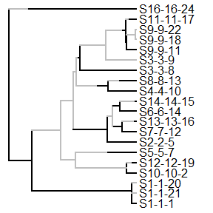
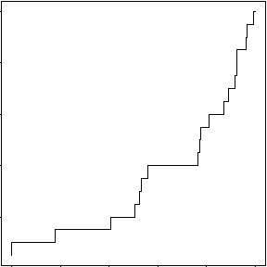
1. Create ‘true’ species trees (simulated)
Notes:
TODO: Add x and y label to picture 2 (nLTT plot)

Slide 9
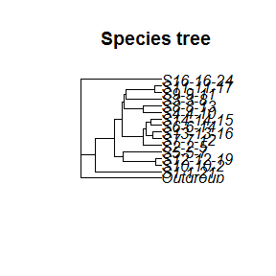
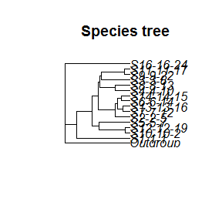
2. Sample a (monophyletic) species trees
Notes:
TODO: Make species names better visible
TODO: Add clearer title to pictures (Sampled tree 1 and 2)

Slide 10
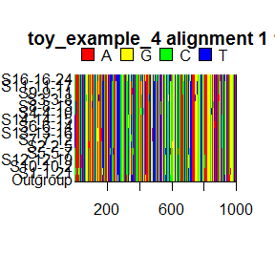
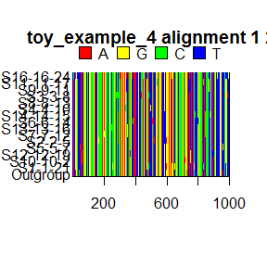
3. Convert to DNA alignment
Input BEAST2
Notes:
TODO: Clearer titles, show that these are 2 random draws sampled tree 1
Q: Should we show the 2 drawn alignments from sampled tree 2 also? Not too much stuff happening in one dia?

Slide 11
4. Infer a posterior (BEAST2)
Output BEAST2
Notes:
TODO: Find picture of posterior Toy example 4

Slide 12
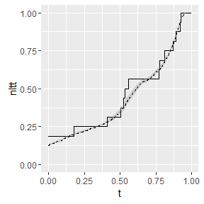
5. Compare posterior with true species tree (step1)
Notes:
TODO: Add legend

Slide 13
Results

Slide 14
Discussion

Slide 15
Conclusion(s)

Slide 16
Questions?
Notes:
POSSIBLE QUESTIONS?:
Q1:

